Slide 1
Utilizing Twitter for Disaster Alerts
By: Tofer Kim, Ritchie Kwan, Will Stecher

Slide 2
Problem Statement
Traditional methods for alerting on disaster-related events like earthquakes and tsunamis rely on information derived from official sources (e.g. USGS).
Our method utilizes social media, specifically Twitter activity, to identify these events and determine when an event first occurs.
Notes:
United States Geological Survey

Slide 3
Investigating Fire Disasters
Public dataset:
10,877 disaster-related tweets, marked either “Relevant” or “Not Relevant”
Collected tweets using keywords and date-ranges:
“wildfire” and “forest fire”
July 11-12, 2018
January 14-15, 2019

Slide 4
Classification Methods
Determine if a tweet is “relevant” or “not relevant” to a disaster-related event
Doc2Vec feature engineering
Logistic Regression
57% baseline score
83.7% accuracy on unseen data

Slide 5
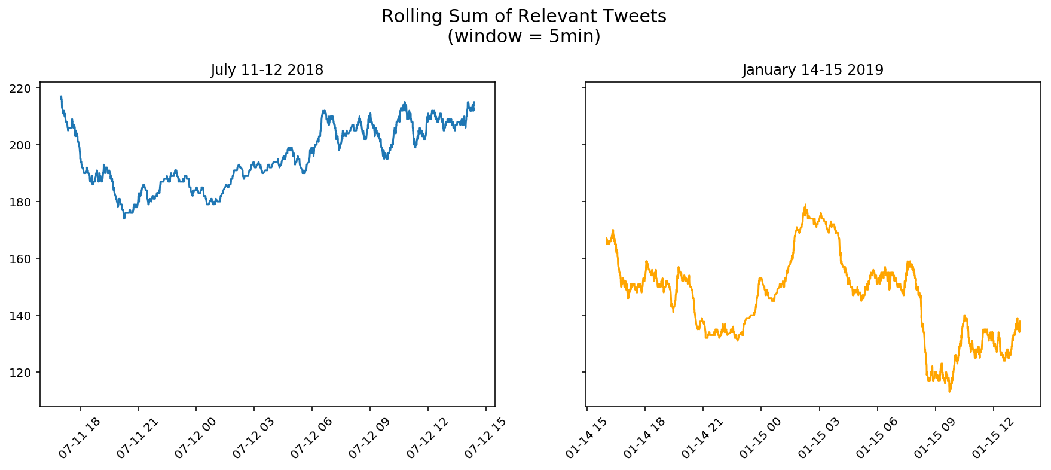
Threshold of ~180 relevant tweets in a five minute window differentiates our time periods.

Slide 6
Next Steps
Build Doc2Vec vocabulary
Larger datasets, tune hyperparameters, rank urgency of tweets
Identify different types of disasters & where they are occurring
Capture and implement geolocation data
Determine thresholds for distinct natural disasters and population sizes

Slide 7
Thank you!

Slide 8
Sources
Training dataset: https://www.figure-eight.com/data-for-everyone/
Doc2Vec and Classification procedures: https://towardsdatascience.com/multi-class-text-classification-with-doc2vec-logistic-regression-9da9947b43f4
Scraping Twitter: https://github.com/Jefferson-Henrique/GetOldTweets-python

